Slide 1
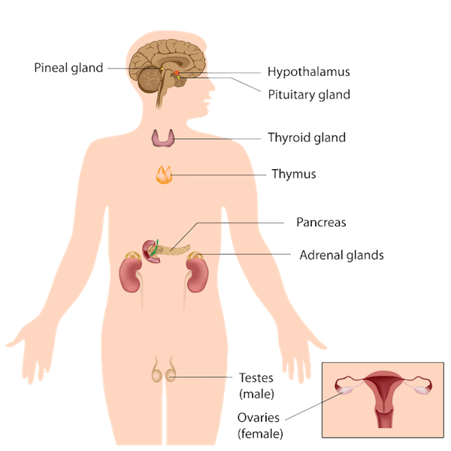
Medical Billing Endocrine System
AREEBA RAFIQ
5098

Slide 2
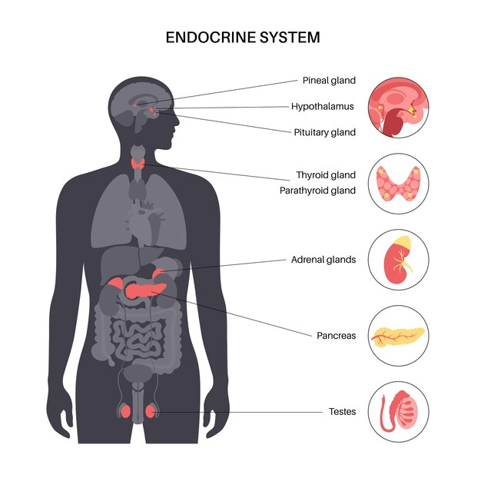
ANATOMY OF ENDOCRINE SYSTEM
The endocrine system is a complex network of glands and organs that produce, store, and secrete hormones, which are chemical messengers that regulate various physiological functions in the body. These hormones play a crucial role in maintaining homeostasis, coordinating growth and development, regulating metabolism, and responding to environmental stimuli

Slide 3
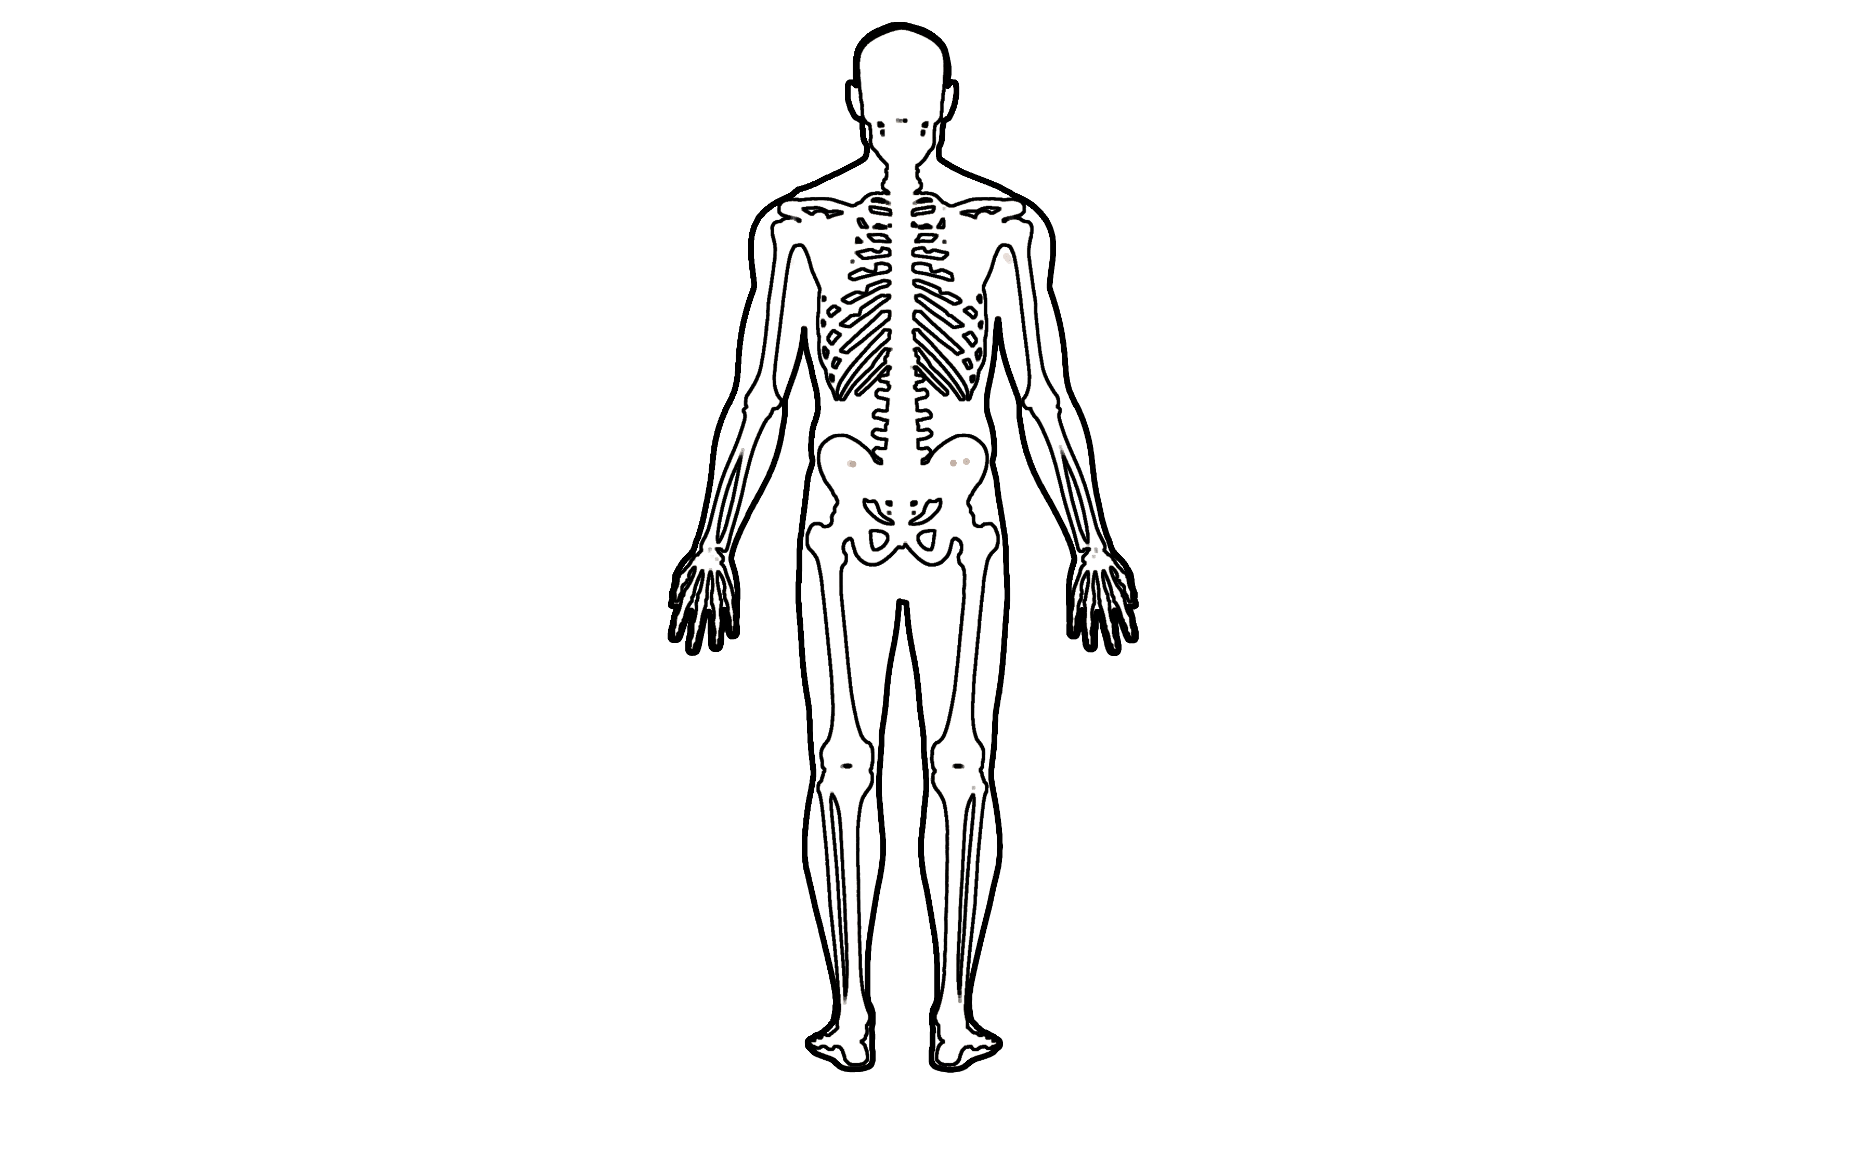
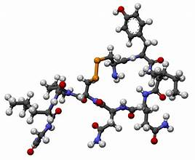
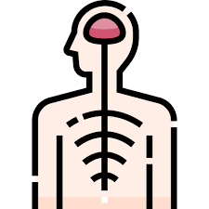
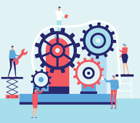
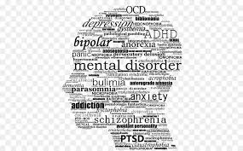
Endocrine System
01
02
03
04
05
Endocrine system anatomy
Components of Endocrine System
Interactions with other systems
Functions of Endocrine System
Disorders

Slide 4
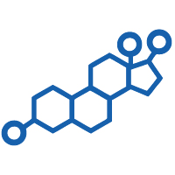
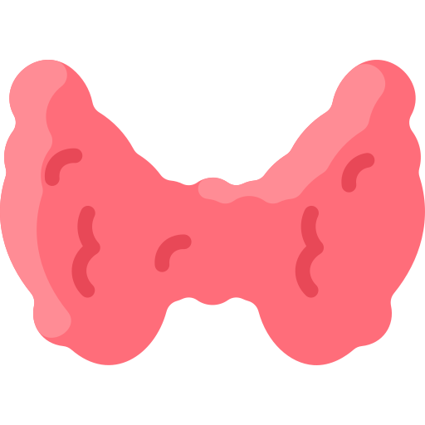
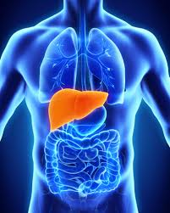
Components of Endocrine System
Hormones
1
They are chemical substances that are carried by a cell tissue and initiate specific action
Glands
2
These are specialized organs that release hormones
directly into the bloodstream
Test Organs
3
The specific cells which are affected by a hormone are called target cells

Slide 5

Hormones
HORMONES: They are chemical substances that are carried by a cell tissue and initiate specific action. Hormones can have very powerful effects, even when present in very low concentrations. The specific cells which are affected by a hormone are called target cells. Hormones travel through the bloodstream to target cells or organs, where they elicit specific responses. Examples of hormones include insulin, cortisol, thyroid hormones, estrogen, and testosterone.

Slide 6
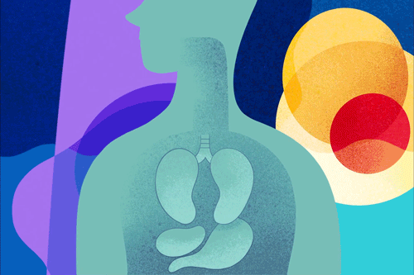
Functions of Hormones
Regulate the chemical composition and volume of the internal environment (extracellular fluid).
Help regulate metabolism and energy balance.
Help regulate contraction of smooth and cardiac muscle fibers and secretion by glands.
Help maintain homeostasis, despite disruptions, such as infection, trauma, emotional stress, dehydration, starvation, hemorrhage, and temperature extremes.
Regulate certain activities of the immune system.
Play a role in the smooth, sequential integration of growth and development.
Contribute to the basic processes of reproduction, including gamete production, fertilization, nourishment of the embryo and fetus, delivery, and nourishment of the newborn

Slide 7
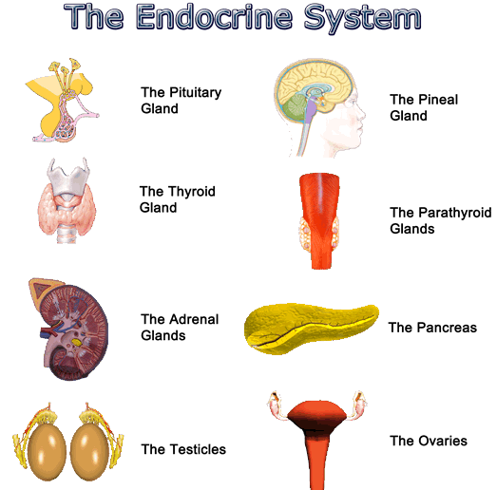
Glands
These are specialized organs that release hormones directly into the bloodstream
Major endocrine glands includes the:
Pituitary gland
Thyroid gland
Adrenal glands
Pancreas
Parathyroid glands
Gonads (testes in males and ovaries in females)

Slide 8
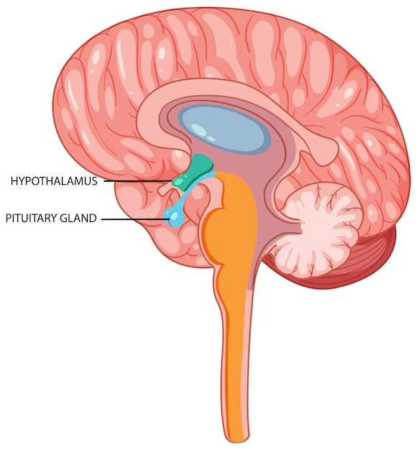
Pituitary Gland
The pituitary gland, often referred to as the "master gland," is a small, pea-sized gland located at the base of the brain It is a crucial component of the endocrine system and plays a central role in regulating various physiological processes in the body.
The pituitary gland consists of two main parts:
Anterior Pituitary (Adenohypophysis): This part produces and releases several hormones, including growth hormone, thyroid-stimulating hormone, adrenocorticotropic hormone, follicle-stimulating hormone, luteinizing hormone, and prolactin.
Posterior Pituitary (Neurohypophysis): This part stores and releases hormones produced by the hypothalamus, including oxytocin and vasopressin (antidiuretic hormone).

Slide 9
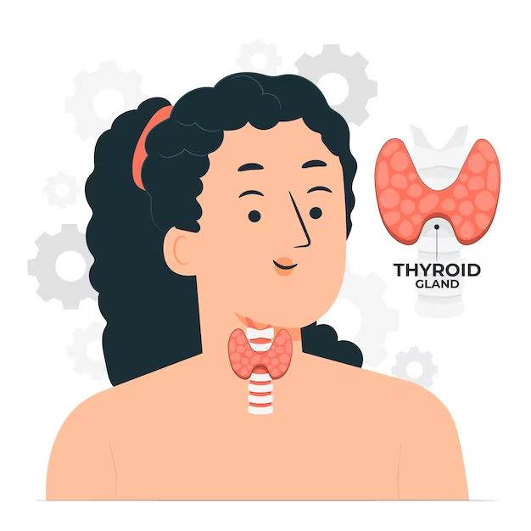
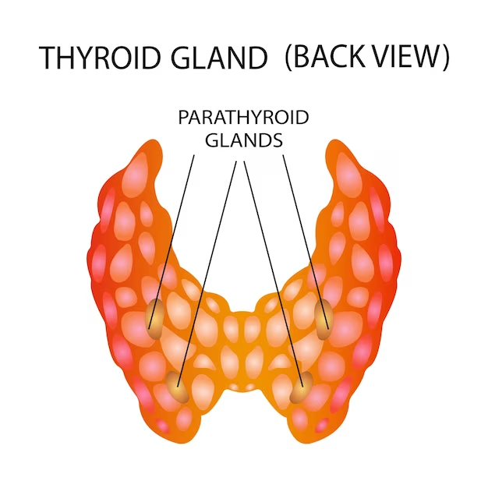
Thyroid Gland
The thyroid gland is a butterfly-shaped endocrine gland located in the neck and produces hormones called thyroxine(T4) and triiodothyronine(T3). These hormones release metabolism, energy production, and body sensitivity to other hormones.
Parathyroid Gland
There are four small parathyroid glands located at the back of the parathyroid glands. They produce parathyroid hormone(PTH) which regulate calcium levels in bone and blood

Slide 10
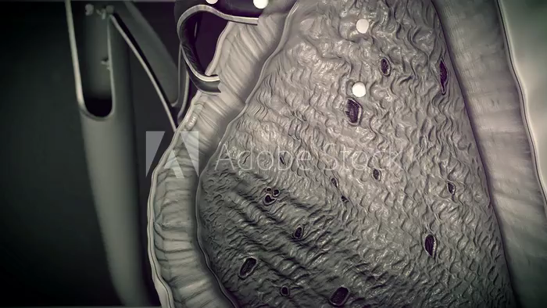
Adrenal Glands
The adrenal glands are a pair
of small, triangular-shaped
endocrine glands located on
top of each kidney and consist of
two parts: the adrenal cortex
and the adrenal medulla.
Adrenal Cortex: Adrenal cortex produces hormones such as cortisol, aldosterone, and sex hormones(androgens). These hormones regulate metabolism, blood pressure, and electrolyte balance.
Adrenal Medulla: The adrenal medulla releases hormones like adrenaline(epinephrine) and norepinephrine, which are involved in the body’s “fight or flight” response to stress.

Slide 11
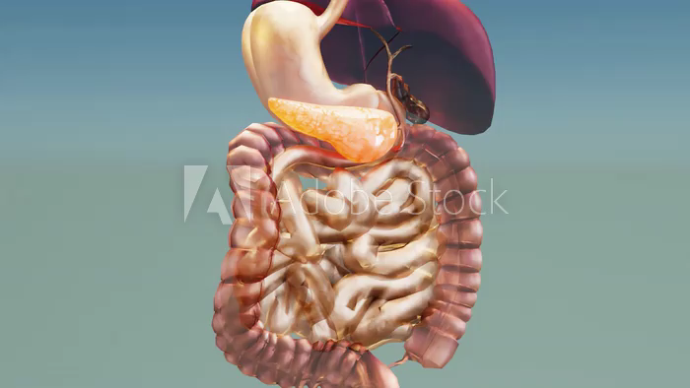
Pancreas
The pancreas is a multifunctional organ involved in both endocrine and exocrine activities. Its endocrine function regulates blood sugar levels through insulin and glucagon, while its exocrine function contributes to the digestive process through the release of pancreatic enzymes
Dysfunction of the pancreas can lead to significant health issues, including diabetes and digestive disorders

Slide 12
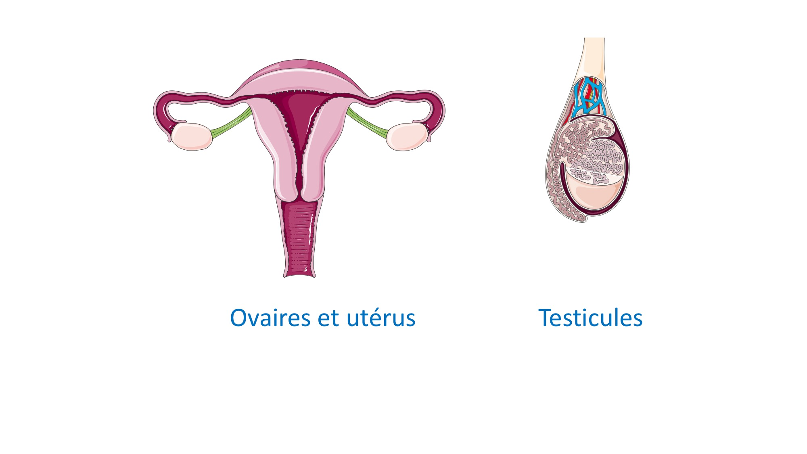
GONADS
"Gonads" is a term used to refer to the reproductive organs responsible for the production of gametes (sex cells) and the secretion of sex hormones. In humans, gonads are present in both males and females and play vital roles in the reproductive system.
Ovaries:
In females, the ovaries produce estrogen and progesterone, which regulate the female reproductive process and secondary sexual characteristics.
Testes:
In males, the testes produce testosterone, which controls male reproductive processes and secondary sexual characteristics

Slide 13
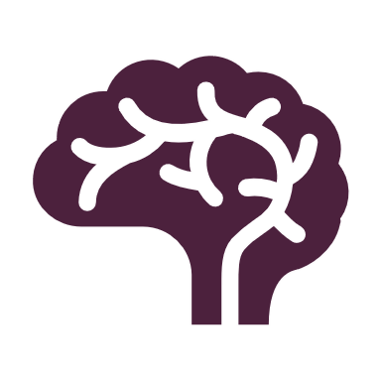
Interactions with the Nervous System
The endocrine system works closely with the nervous system to regulate and coordinate bodily functions. While the nervous system uses electrical impulses and neurotransmitters for rapid, short-term communication, the endocrine system employs hormones for slower, long-term communication

Slide 14
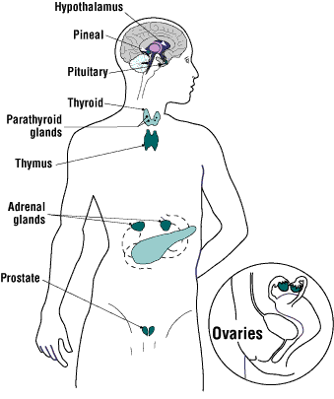
Function of Endocrine System
The endocrine system is involved in numerous physiological processes, including:
Regulation of metabolism (e.g., insulin and glucagon in the pancreas)
Control of growth and development (e.g., growth hormone from the pituitary gland)
Regulation of the sleep-wake cycle (e.g., melatonin from the pineal gland)
Maintenance of electrolyte balance (e.g., aldosterone from the adrenal glands)
Control of reproductive functions (e. g., estrogen and testosterone)

Slide 15
Disorders of Endocrine System
Diabetes Mellitus
1
2
Cushing’s Syndrome (E24.9)
TYPE 1(E10)
TYPE 2(E11)
Hyperthyroidism
3
4
Addison’s Disease
5
6
Hypogonadism
PCOS(E28.2)

Slide 16
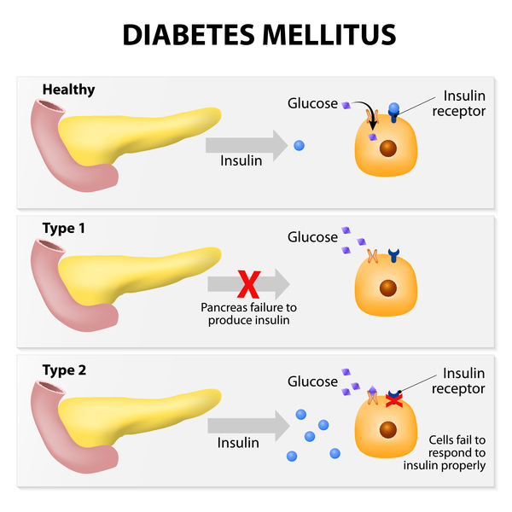
Diabetes Mellitus Type 1 (E10)
Type 1 diabetes mellitus (T1D) is an autoimmune disease that leads to the destruction of insulin-producing pancreatic beta cells
T1D require life-long insulin replacement with multiple daily insulin injections daily, insulin pump therapy, or the use of an automated insulin delivery system

Slide 17
Diabetes Mellitus Type 2(E11)
It is characterized by high levels of sugar in the blood
Type 2 diabetes is a long-term medical condition in which your body doesn't use insulin properly, resulting in unusual blood sugar levels
Type 2 diabetes mellitus (T2DM) accounts for around 90% of all cases of diabetes

Slide 18
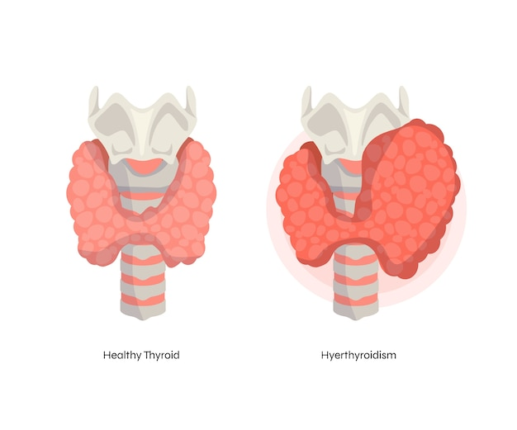
Hyperthyroidism
Hyperthyroidism happens when the thyroid gland makes too much thyroid hormone
This condition also is called overactive thyroid
Hyperthyroidism speeds up the body's metabolism. That can cause many symptoms, such as weight loss, hand tremors, and rapid or irregular heartbeat

Slide 19
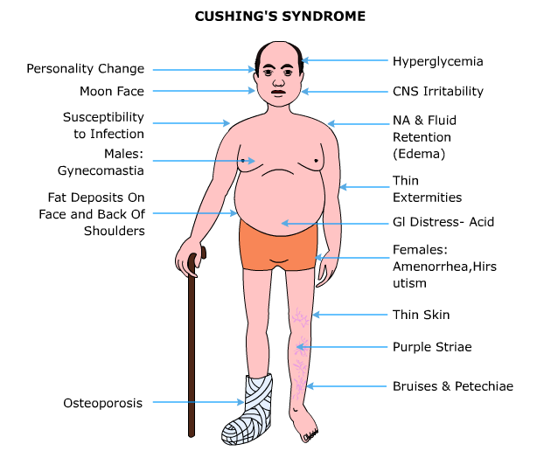
Cushing Syndrome
Cushing disease (also called Cushing's disease or hypercortisolism) occurs when your body makes too much cortisol, a hormone related to the body's stress response
It's a rare pituitary disorder that is progressive. That means that without treatment, it gets worse over time

Slide 20
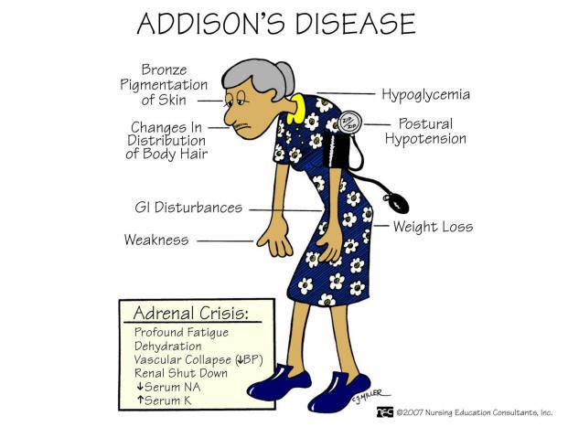
Addison’s Disease
Addison's disease, also called adrenal insufficiency, is an uncommon illness that occurs when the body doesn't make enough of certain hormones
In Addison's disease, the adrenal glands make too little cortisol and, often, too little of another hormone, aldosterone

Slide 21
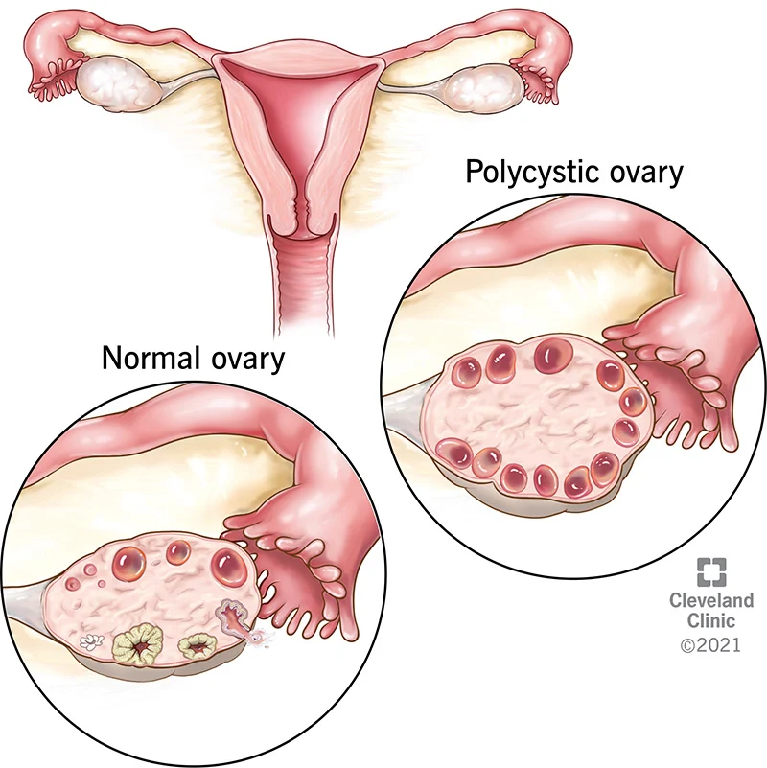
Polycystic Ovary Syndrome(PCOS)
Polycystic ovary syndrome is a condition in which your hormones are out of balance(androgens)
The syndrome is named after cysts which form on the ovaries
PCOS can be associated with problems such as irregular menstrual cycles, excessive facial and body hair growth, acne, obesity, reduced fertility and increased risk of diabetes

Slide 22
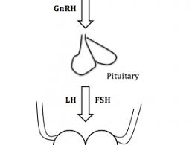
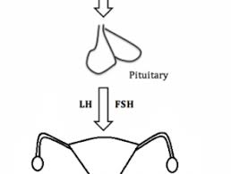
Hypogonadism
Hypogonadism occurs when the body's sex glands (gonads) produce little or no hormones
In men, these glands are the testes. Low testosterone (male hypogonadism) is a condition in which your testicles don't produce enough testosterone
Hypogonadism in females describes the inadequate function of the ovaries, with impaired production of germ cells (eggs) and sex hormones (estrogen and progesterone)

